Slide 1
Ash Winter
Short stuff here:
@northern_tester
Long stuff here:
testingisbelieving.blogspot.co.uk

Slide 2

That’s me, what about you?
Pair up!
Three post its:
Your name
Example of hard to test
Action to correct (if any)
Add to the board

Slide 3
Revealing Architectural Testability

Slide 4
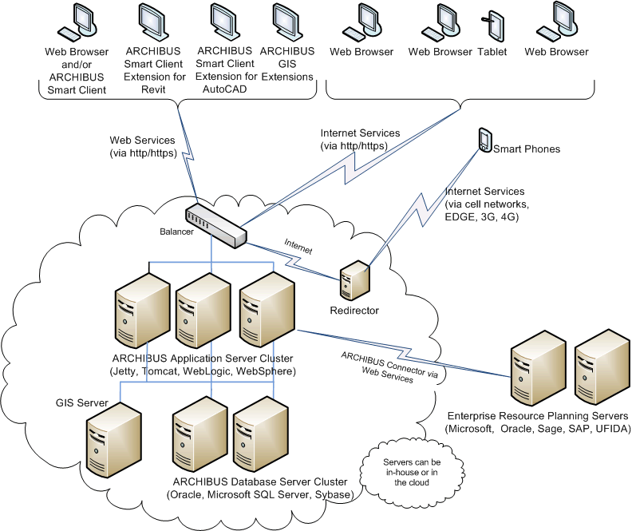
What do I mean by architecture?
Social, abstract
Shared understanding of:
Consumers
Components
Interactions
Layers
Fallible – no one model understood commonly by all stakeholders!

Slide 5
What do I mean by testability?
How easy or hard it is to test?
Observe effects of an action
Control the state of the system
Understand the risks, boundaries of the system

Slide 6
Hard to Test?
Do more of the testing that testers do
Hiring more testers

Slide 7
Hard to Test?
Moar automation
Making a mockery
Fire and forget into Production

Slide 8

Important for all…
Testability benefits all
Testers contribute early
Developers get feedback
Operations support effectively

Slide 9
Comfort…
With architecture
0 or I have no idea
5 or I can contribute to architectural discussions
10 or I’m an architect actually…
Add your mark to the scale
Decision time!

Slide 10

Follow the path…
Smells – Symptoms of hard to test
Puzzle – using oracles to express architecture
Canvas – mapping risk and remedy
Infinite – maintaining your focus
Migration – testability and changing architectures

Slide 11

Exercises
Groups
Visible
Questions
Breaks

Slide 12

Begin!

